Slide 1


Session 5
Complex Systems

Slide 2
Topics for the session
Tiger kidnappings
Security in work
Security with friends
Security in relationships
Security in families.

Slide 3
Freedom of information
In the second week of this course we asked Surrey County Council about children that had been removed from school rolls…
They have now returned to us: https://www.whatdotheyknow.com/request/children_removed_from_school_rol
What do I do next?

Slide 4
Tiger Kidnappings
What’s a tiger kidnapping?

Slide 5
Tiger Kidnappings
What’s a tiger kidnapping?
A tiger kidnapping or tiger robbery involves two separate crimes. The first crime usually involves an abduction of a person or something someone highly values. Instead of demanding money, the captors demand that a second crime be committed on their behalf.
“We’ve got your mum, now take all the money out of the work safe or she gets it”

Slide 6
More tiger kidnappings
Put yourself in the position of an armed gang who find out about a venue with millions of pounds in cash.
The gang decide to use a Tiger kidnapping, what’s the risks?

Slide 7
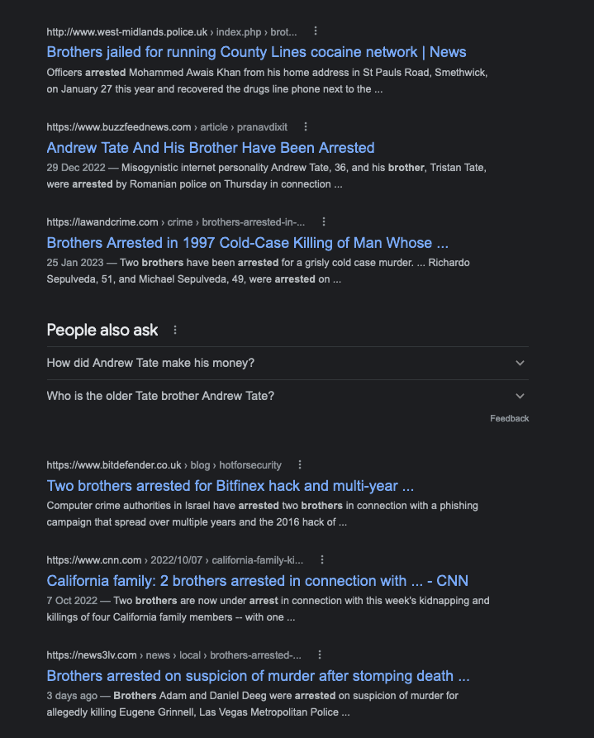
Cloaked Tiger Kidnappings
Success rests in the quality of your relationships
So does prison.

Slide 8
Today’s session: Organisational Security
Organisations that you are part of:

Slide 9
Today’s session: Organisational Security
Organisations that you are part of:
Work
Family
Friends
Other Friends

Slide 10
Work Security
Work is easy. Someone there will tell you the rules:
Encrypt this laptop hard drive
Never send attachments, only links
These are the rules for which files you can access.
Someone is employed to do the risk assessment
Also - the consequences are obvious:
Verbal warning
Written warning
Sacked
When can you break these rules?

Slide 11
Romantic Security
Bit harder.
Digital intimacy is a thing. It should be treated like any other type of intimacy.
Abuse is also a thing.
Who is allowed to see select screenshots of your conversations? Under what circumstances?
When can you break these rules?
How can you protect yourself from abuse?

Slide 12

Friend group security
Bit harder
“The group chat”
But what else?
Permission to take a photo
What’s on the table for mockery?
What are the individual and group boundaries?
Who can share screenshots? When?
When can you break the rules?
Notes:
Put in the warwick example

Slide 13
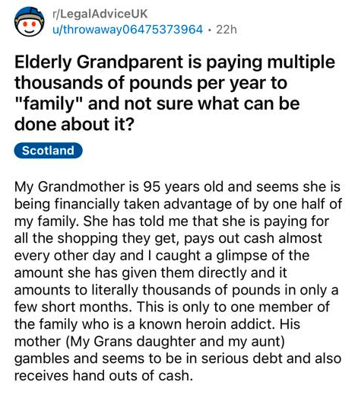
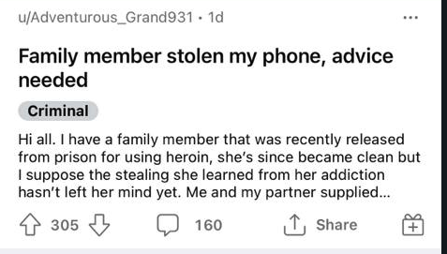
Family Security
Literally the hardest security problem. How to get a multigenerational group with complex power-dynamics to follow the same set of rules about security?

Slide 14
Family Security - why is it hard?
Changing roles
Teenagers turning into adults
Family members losing capacity
New family members - partners, step-children, new babies
Uneven power distribution
Uneven power breeds secrecy. Secrecy breeds mistrust.
Individuals balancing power with security from both outside and inside the family.

Slide 15

Family Security Questions To Ask yourself
Is it okay that my family talk about my work with their friends?
Do I even tell my family about my work?
Is it okay to publicly share family pictures? How about naked baby pictures?
Who handles the physical security in your home? Who handles the digital? The financial? The ‘informational’ security?
Do people have respected private places? Should they?
What does the family risk assessment look like?

